Slide 1
Classification about Kannada MNIST using CRNN
201920951 소프트웨어학과 김주안

Slide 2
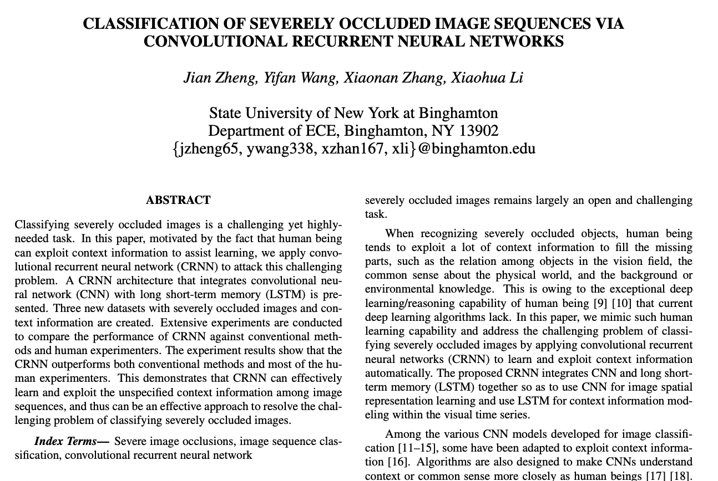
Why did I select this topic ?
Topic : CRNN을 이용한 폐색 영상 분류
Q) 기본적인 Dataset인 MNIST에
적용해보면 좋은 성능이 나올까 ?

Slide 3
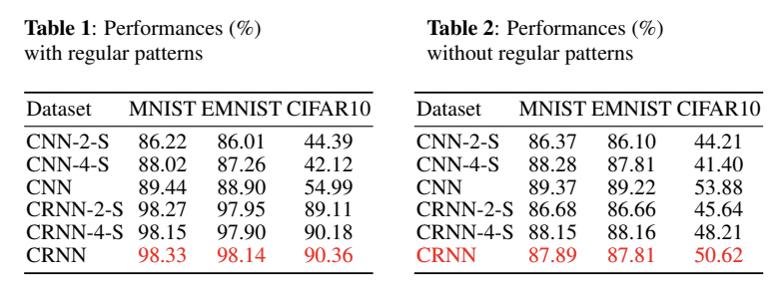
Why did I select this topic ?
=> Occluded image의 경우 성능 개선을 확인할 수 있다.

Slide 4
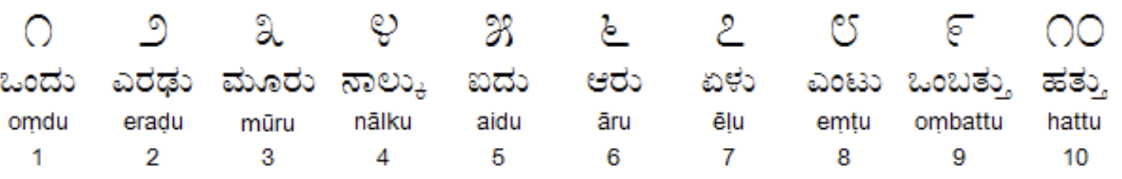
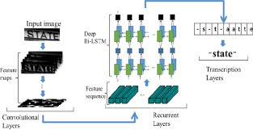
Project preview
What is a Kannada?
Kannada is a language spoken
Predominantly by people of
Karnataka in southwestern India.
Main Algorithm
CRNN = CNN + RNN
Fig.1 Text recognition using CRNN

Slide 5
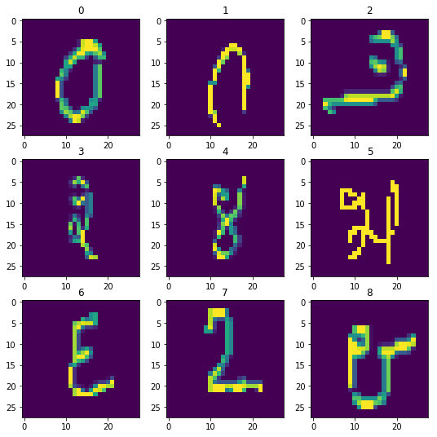
Check a dataset
Training Data Shape | (54000, 28, 28, 1) Sample 54,000 28 x 28 image 1 channel
Test Data Shape | (5000, 28, 28, 1) Sample 5,000 28 x 28 image 1 channel
Validation Data Shape | (6000, 28, 28, 1) Sample 6,000 28 x 28 image 1 channel

Slide 6
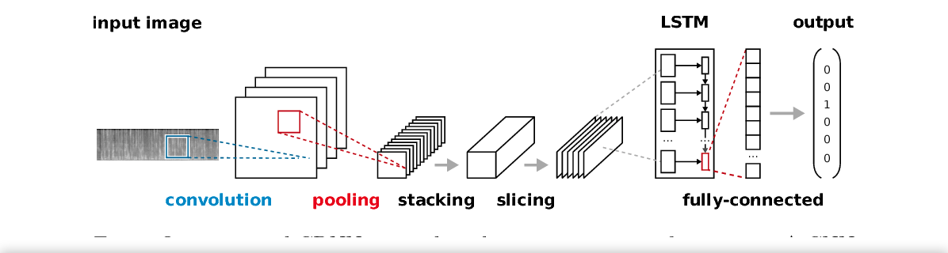
Model
Layers – There are mainly three layers in CRNN architecture
Convolutional Layer – Extracts features through CNN layer
Recurrent Layer – Splits the features into a certain size and inserts them into the input of the Bidirectional LSTM or GRU
Transcription Layer – Conversion of Feature-specific predictions to Label using CTC(connectionist Temporal Classification)

Slide 7
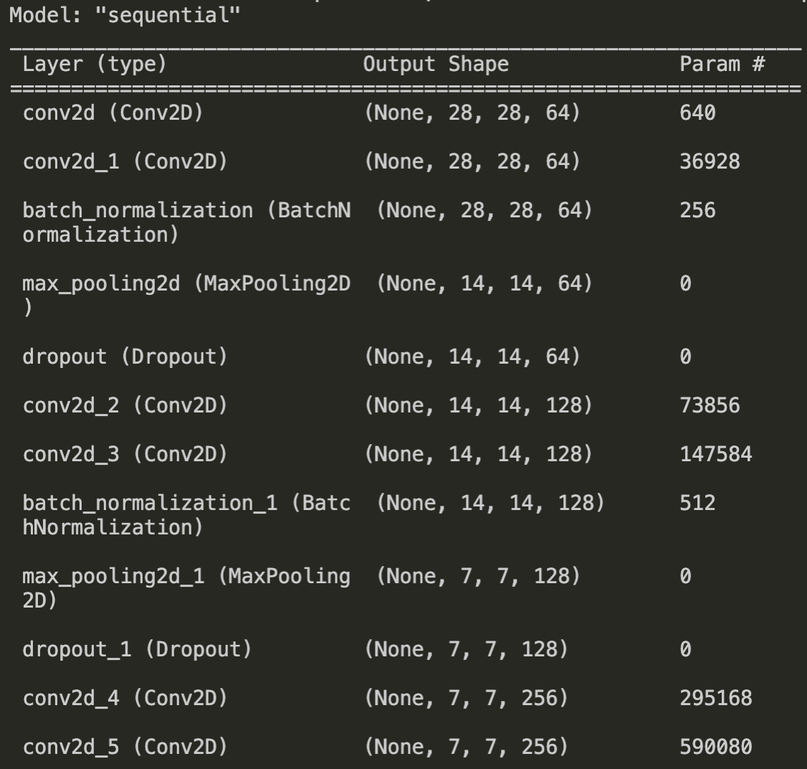
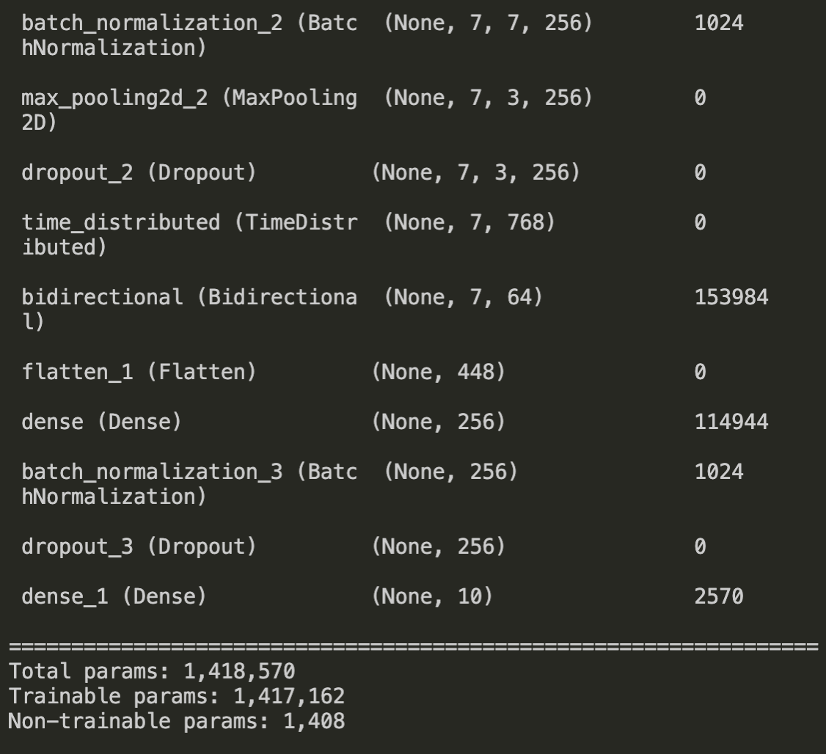
Model.summary()

Slide 8
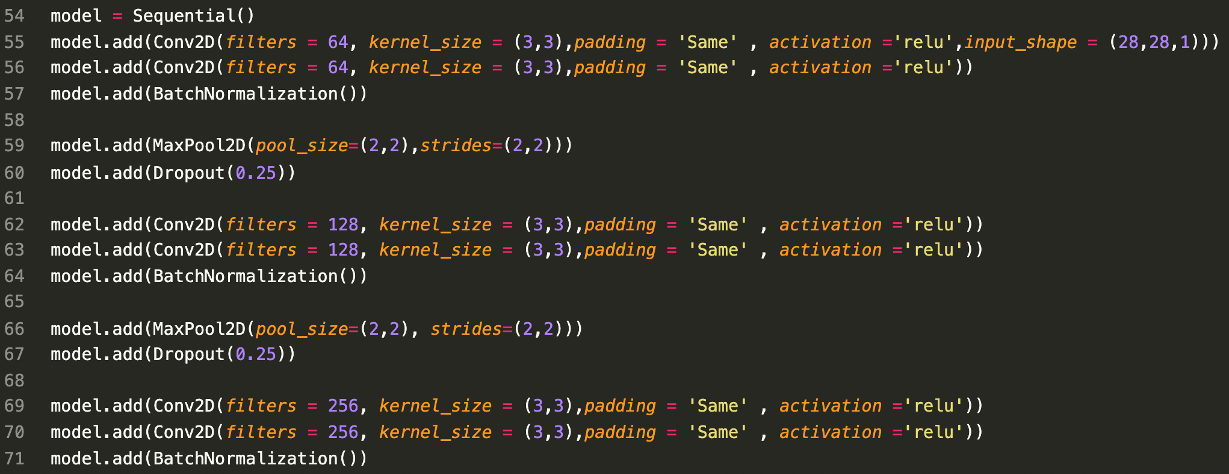
Layers

Slide 9
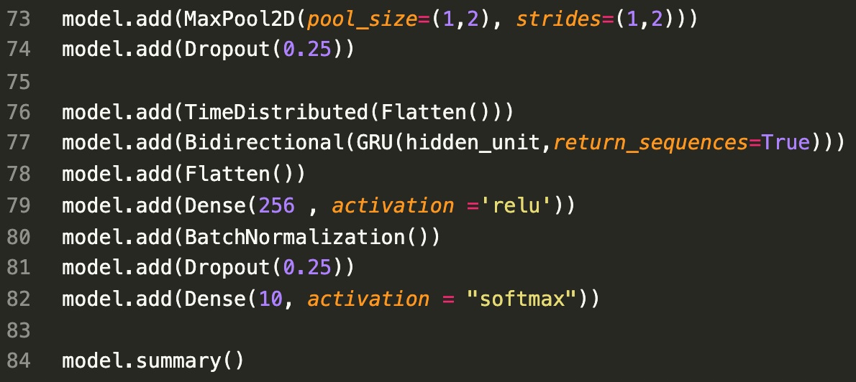
Layers

Slide 10
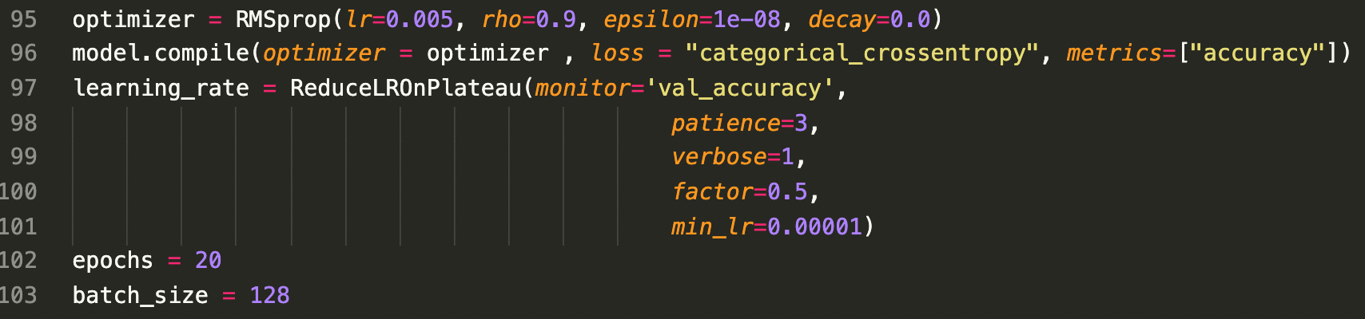
H-parameter that I used

Slide 11
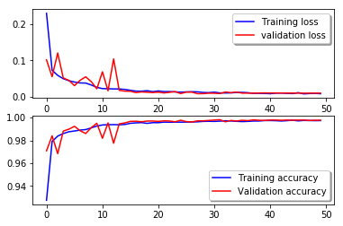
Result
학습을 할수록 loss가
줄어들고
accuracy가 향상 되는 것으로 보아
어느 정도 학습이 잘 되는 것으로 판단할 수 있다.

Slide 12
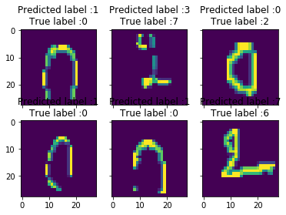
Some error results
0 인 숫자를 1 로 예측
7 인 숫자를 3 으로 예측
2 인 숫자를 0 으로 예측

Slide 13
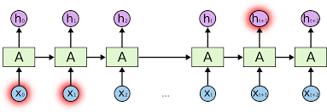
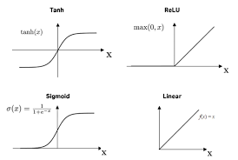
Things to do next
Add more LSTM network | Different activation function

Slide 14

Thanks for watching
201920951 소프트웨어학과 김주안

